Slide 1
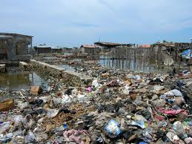
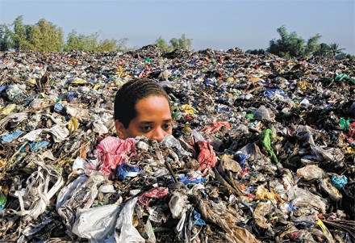
SOLID WASTE MANAGEMENT
Naveen Sharma
Assistant Professor
Deptt. of Envtl. Sc.
Govt. PG College, Rajouri

Slide 2
Factors That Contribute To the Solid Waste Generation

Slide 3
Solid Waste:
“Heterogenous mass of discarded material”
SOLID WASTE MANAGEMENT
The discipline associated with the control of generation, storage, collection, transfer and transport, processing and disposal of solid waste in manner that is accordance with the best principles of public health, economic, engineering, conservation, aesthetics and environmental consideration.
INTEGRATED SOLID WASTE MANAGEMENT ?
The selection and application of suitable techniques, technologies and management programs to achieve specific waste management objective and goals

Slide 4
Classification of Wastes according to their Properties
Bio-degradable
can be degraded (paper, wood, fruits and others)
Non-biodegradable
cannot be degraded (plastics, bottles, old machines,cans, styrofoam containers and others)

Slide 5
Classification of wastes according to their origin and type
Municipal Solid wastes: Solid wastes that include household garbage, rubbish, construction & demolition debris, sanitation residues, packaging materials, trade refuges etc. are managed by any municipality.
Bio-medical wastes: Solid or liquid wastes including containers, intermediate or end products generated during diagnosis, treatment & research activities of medical sciences.
Industrial wastes: Liquid and solid wastes that are generated by manufacturing & processing units of various industries like chemical, petroleum, coal, metal gas, sanitary & paper etc.
Agricultural wastes: Wastes generated from farming activities. These substances are mostly biodegradable.
Radioactive wastes: Waste containing radioactive materials. Usually these are byproducts of nuclear processes. Sometimes industries that are not directly involved in nuclear activities, may also produce some radioactive wastes, e.g. radio-isotopes, chemical sludge etc.
E-wastes: Electronic wastes generated from any modern establishments. They may be described as discarded electrical or electronic devices. Some electronic scrap components, such as CRTs, may contain contaminants such as Pb, Cd, Be or brominated flame retardants.

Slide 6
SOURCES AND OTHER TYPES OF WASTE
Source | Typical Waste Generators | Types of solid wastes
1:Residential | Single and multifamily dwellings | Food wastes Paper Cardboard Plastics Textiles Leather Yard wastes Wood Glass Metals Ashes Special wastes (e.g bulky items, consumer electronics, white goods, batteries, oil, tires), and household hazardous wastes.)

Slide 7
2: Industrial | Light and heavy manufacturing, fabrication, construction sites, power and chemical plants. | Housekeeping wastes Packaging Food wastes Construction and demolition materials Hazardous wastes Ashes Special wastes.
3:Commercial | Stores, hotels, restaurants, markets, office buildings, etc. | Paper cardboard plastics wood food wastes glass metals special wastes hazardous wastes
4: Institutional | Schools, hospitals, prisons, government centers. | Same as commercial.

Slide 8
5:Construction and demolition | New construction sites, road repair, renovation sites, demolition of buildings | Wood steel concrete dirt etc.
6:Municipal services | Street cleaning, landscaping, parks, beaches, other recreational areas, water and wastewater treatment plants. | Street sweepings landscape and tree trimmings General wastes from parks Beaches Recreational areas; sludge.
7:Process (manufacturing etc.) | Heavy and light manufacturing, refineries, chemical plants, power plants, mineral extraction and processing. | Industrial process wastes Scrap materials Off-specification products.
8:Agriculture | Crops, orchards, vineyards, dairies, feedlots, farms. | Spoiled food wastes Agricultural wastes Hazardous wastes (e.g., pesticides).

Slide 9
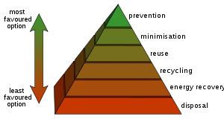
Waste hierarchy refers to 3 Rs Reduce, Reuse, Recycle
Waste hierarchy

Slide 10
REUSE
- Reuse corrugated moving boxes internally.
- Reuse office furniture and supplies, such as interoffice envelopes, file folders, and paper.
- Use durable towels, tablecloths, napkins, dishes, cups, and glasses.
- Use incoming packaging materials for outgoing shipments.
- Encourage employees to reuse office materials rather than purchase new ones.
REDUCE
- Reduce office paper waste by implementing a formal policy to duplex all draft reports and by making training manuals and personnel information available electronically.
- Improve product design to use less materials.
- Redesign packaging to eliminate excess material while maintaining strength.
- Work with customers to design and implement a packaging return program.
- Switch to reusable transport containers.
- Purchase products in bulk.

Slide 11
Solid Waste
Disposal Path
Waste Collection
Waste Reception & Transfer
Waste disposal
Solid Waste Disposal Methods
Open dumping
Sanitary landfill
Incineration
Composting
Pyrolysis
High-temperature
Size reduction (shredding, grinding pulverizing)

Slide 12
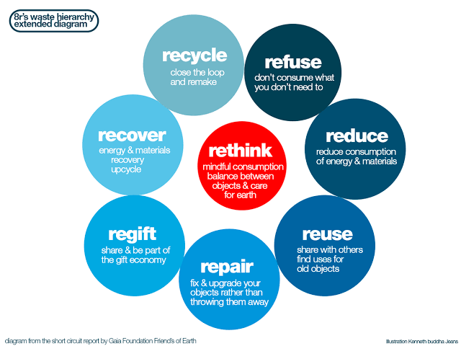
8R’s CONCEPT OF
WASTE MANAGEMENT

Slide 13
THANK YOU

